Slide 1
Plan, Schedule, Test Community Portal
Module Project
Module: Application Implementation (Agile Project Management)
Course:
Start Date :13-07-2023
End Date : 24-07-2023
Submission Date : 24-07-2023
Learner Name : Muhammad Kemal
Enrollment ID : BDSE0922-084
Presentation Date : 26-07-2023

Slide 2
Contents
Document History
Version Number | Effective Date of release | Summary of Included Changes | Author
1 | 4th March 2016 | First Edition | Satya CVS
2 | 23rd Jul 2018 | Changed for Module 6 | Shrinivas K R

Slide 3
Contents
Contents
S. No. | Description
01 | Different Types of Testing
02 | How Different Testing Helps
03 | Tests Selected
04 | Test Schedule
05 | Test Results
06 | Testing Tools
07 | Project Milestone & Tasks
08 | Milestone Feedback & Action Taken
09 | Modifications Made Based on Feedback
10 | Project Results
11 | Proposed Improvements

Slide 4
1. Different Types of Testing
List types of Testing
A. Functional Testing
Compatibility Testing (Cross-Browser Testing)
A functional testing technique is compatibility testing, more specifically Cross-Browser Testing. This guarantees that the product works as intended on different web browsers and versions. These tests help ensure that application functionality remains independent of the end user's browser.
UAT Test (User Acceptance Testing)
is a test performed by the end user or the testing team, the main focus is ensuring that the software meets the needs and expectations of the end user and is carried out at the final stage of development

Slide 5
1. Different Types of Testing
B. Non-Functional Testing
Performance Testing:
Portability Testing (Multiple Devices / Platforms):
A non-functional testing technique is performance testing. It assesses system performance under various circumstances, including load, stress, and scalability. The software must support the anticipated user load and provide a responsive and reliable user experience. Udah ini tambah yg di word
Portability testing is a non-functional testing methodology determining the ease or difficulty of moving a software component or application from one environment to another. The test results obtained from Portability Testing help determine how easily a software component from one environment can be used in another environment. The term ‘environment’ refers to moving from one operating system to another operating system, one browser to another browser or from one database version to another database version.

Slide 6
2. How Different Test Helps
UAT Test (User Acceptance Testing)
Compatibility Testing (Cross-Browser Testing):
Performance Testing:
Portability Testing (Multiple Devices / Platforms):

Slide 7
3. Tests Selected
Functional Testing
UAT Testing
UT Testing
Non-Fucntional testing
Compability Testing
Performance Testing
Portability Testing

Slide 8
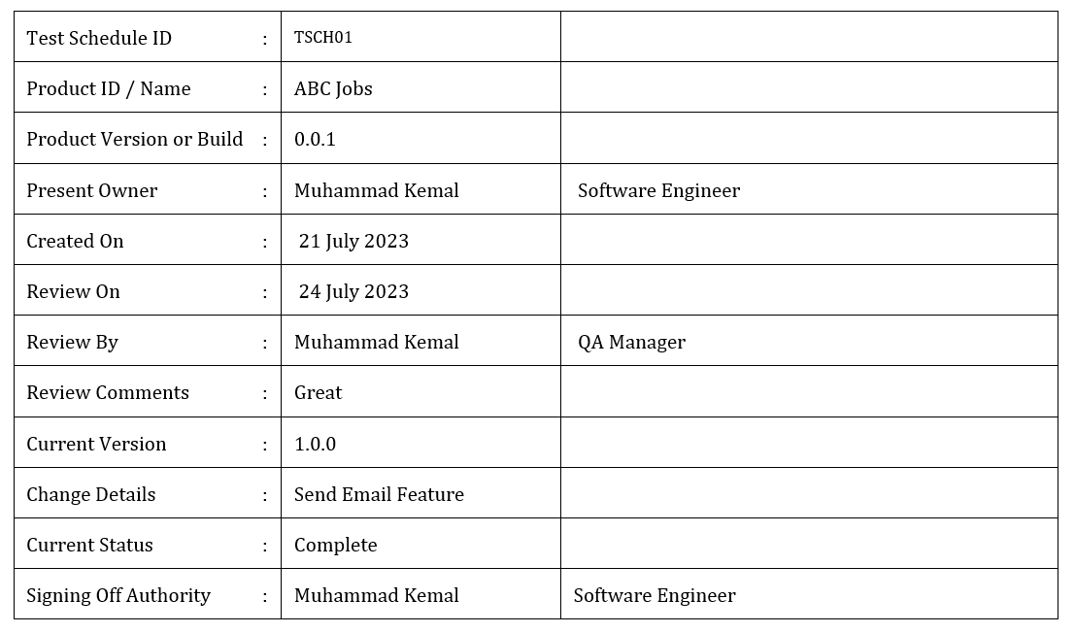
4. Test Schedule

Slide 9
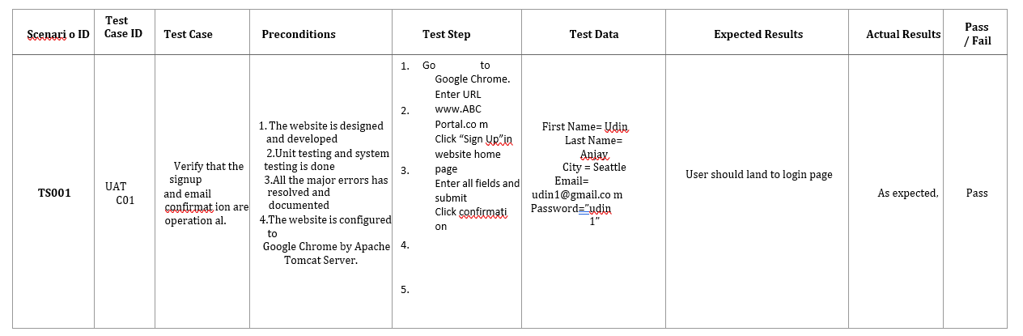
5. Test Results
Unit Testing
register

Slide 10
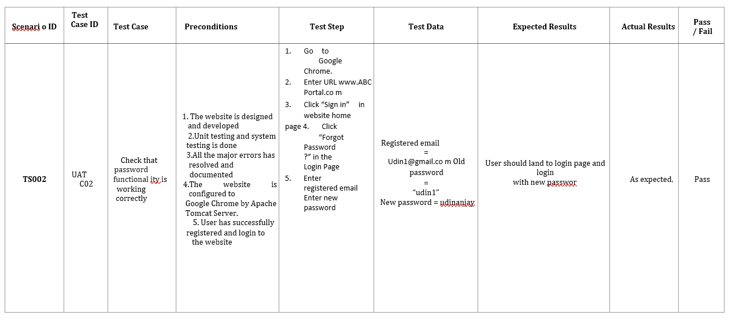
5. Test Results
UAT Testing
Forgot password

Slide 11





6. Testing Tools
Testing Tools

Slide 12
7. Project Milestones & Tasks
Project Task ID | Project Task Description | Project Milestone ID
1 | Analyze and suggest choice of Test Methods | 1
2 | Schedule the Test Optimally | 1
3 | Develop the Phase Test Plan | 1
5 | Develop Test Cases & Scripts | 2
6 | Execute the Tests & Document the results | 3

Slide 13
8. Milestone Feedback & Action taken
Project Milestone ID | Milestone Feedback received from Tutor / Learning Facilitator | Action Taken (Yes / No)
1
2
3

Slide 14
9. Modifications Made based On Feedback

Slide 15
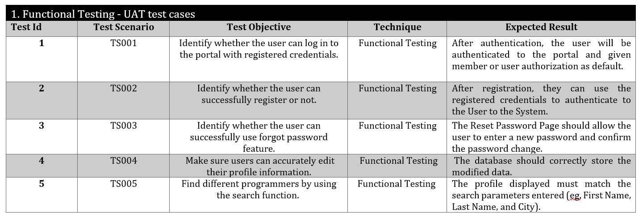
10. Project Results

Slide 16
11. Proposed Improvements
List of Improvements
Update a waterfall model specifically and in accordance with the plan
Try use other SDLC Model and compare with Waterfall model

